Slide 1


Betty Schrampfer Azar
Stacy A. Hagen
Teacher Resource Disc
Slide shows for use with
PowerPoint presentation software
Laurette Poulos Simmons
Copyright © 2007 by Pearson Education, Inc.
All rights reserved.

Slide 2

CONTENTS
3-1 Form and basic meaning of the simple present tense
3-2 Using frequency adverbs: always, usually, often,…
3-3 Other frequency expressions
3-4 Using frequency adverbs with be
3-5 Spelling and pronunciation of final -es
3-6 Adding final -s/-es to words that end in -y
3-7 Irregular singular verbs: has, does, goes
3-8 Spelling and pronunciation of final -s/-es
3-9 The simple present: negative
3-10 The simple present: yes/no questions
3-11 The simple present: asking information questions with where
3-12 The simple present: asking information questions with when… 3-13 Summary: information questions with be and do

Slide 3
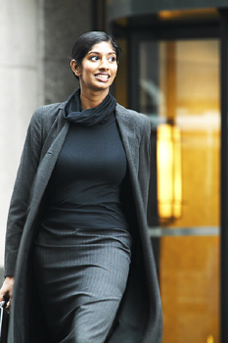
3-1 FORM AND BASIC MEANING OF THE SIMPLE PRESENT TENSE
She walks.

Slide 4
3-1 FORM AND BASIC MEANING OF THE SIMPLE PRESENT TENSE
SINGULAR PLURAL
1st PERSON
I walk
we walk
2nd PERSON
you walk
you walk
3rd PERSON
she walks
he walks
it walks
they walk

Slide 5
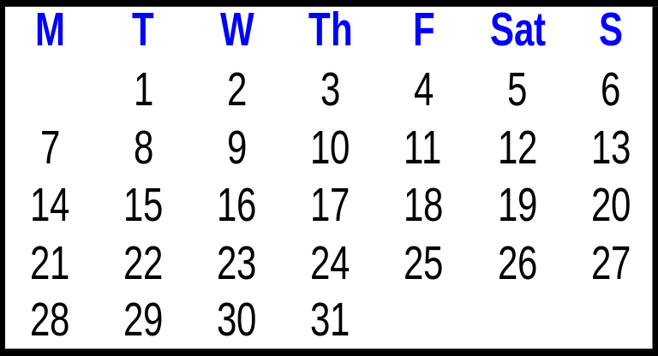
3-1 FORM AND BASIC MEANING OF THE SIMPLE PRESENT TENSE
(a) I eat lunch every afternoon.
(b) Max drives to work every day.
(c) We get up every morning.
(d) Kyle calls Mimi every weekend.
Monday
Tuesday
Wednesday
Thursday
Friday
Saturday
Sunday
HABITS = USUAL ACTIVITIES

Slide 6
3-1 Let’s Practice
We _____ television every day.
watch
watch
watches

Slide 7
3-1 Let’s Practice
watches
He _______ television every day.
watch
watches

Slide 8
3-1 Let’s Practice
eat
We ____ lunch at 12:00.
eat
eats

Slide 9
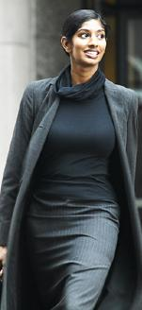
3-1 Let’s Practice
Jara _____ a walk in the morning.
takes
take
takes

Slide 10
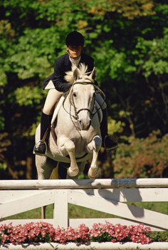
3-1 Let’s Practice
My friend ____ her horse every day.
rides
ride
rides

Slide 11
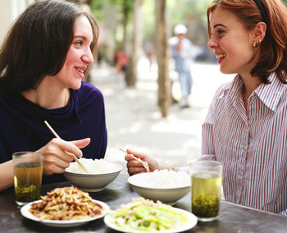
3-2 USING FREQUENCY ADVERBS: ALWAYS, USUALLY, OFTEN, SOMETIMES, SELDOM, RARELY, NEVER
They always drink tea with lunch.

Slide 12
3-2 USING FREQUENCY ADVERBS: ALWAYS, USUALLY, OFTEN, SOMETIMES, SELDOM, RARELY, NEVER
100%
(a) Mary always eats lunch at school.
90%- 99%
(b) Mary usually eats lunch at school.
75%- 90%
(c) Josh often eats hamburgers.
25%- 75%
(d) Tia sometimes eats lunch at school.
5%- 10%
(e) Tia seldom eats lunch at school.
1%- 10%
(f) Eva rarely washes her car.
0%
(g) Jay never goes to the zoo.
frequency adverbs

Slide 13
3-2 Let’s Practice
always
usually
often
sometimes
seldom
rarely
never
Talia _______ feeds her dog.
always
Sun.
Mon.
Tues.
Wed.
Thurs.
Fri.
Sat.
√
√
√
√
√
√
√

Slide 14
3-2 Let’s Practice
always
usually
often
sometimes
seldom
rarely
never
Jara ______ watches TV.
seldom
Sun.
Mon.
Tues.
Wed.
Thurs.
Fri.
Sat.
√

Slide 15
3-2 Let’s Practice
always
usually
often
sometimes
seldom
rarely
never
Luke _______ cooks dinner.
usually
Sun.
Mon.
Tues.
Wed.
Thurs.
Fri.
Sat.
√
√
√
√
√
√

Slide 16
3-2 Let’s Practice
always
usually
often
sometimes
seldom
rarely
never
Moussad _________ cooks
dinner.
sometimes
Sun.
Mon.
Tues.
Wed.
Thurs.
Fri.
Sat.
√
√
√
√

Slide 17
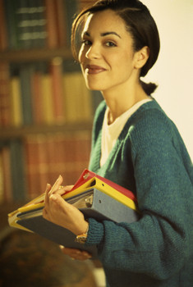
3-3 OTHER FREQUENCY EXPRESSIONS
She goes to
the library
once a week.

Slide 18
3-3 OTHER FREQUENCY EXPRESSIONS
once a week.
twice a week.
five times a week.
(a) She goes to the library
Sun.
Mon.
Tues.
Wed.
Thurs.
Fri.
Sat.
√
√
√
√
√
√

Slide 19
3-3 OTHER FREQUENCY EXPRESSIONS
(b) I go to school five times a week.
(c) I go to the movies twice a month.
(d) I go to the beach once a year.
how many times
a day a week
a month a year

Slide 20
3-3 OTHER FREQUENCY EXPRESSIONS
(e) I feed my dog every morning.
I ride my horse every week.
Every
is
singular.
I wash my car every year.
Correct?
no
every weeks

Slide 21
3-3 Let’s Practice
How often do you drink coffee?
Every
morning.

Slide 22
3-3 Let’s Practice
So you
drink coffee?
always
usually
often
sometimes
seldom
rarely
never
always
Yes.

Slide 23
3-3 Let’s Practice
I know. She
drinks coffee.
Mei doesn’t drink coffee.
never
always
usually
often
sometimes
seldom
rarely
never

Slide 24
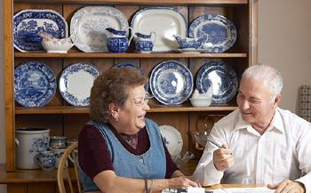
3-3 Let’s Practice
Does Dr. Aboud take a walk every day?
No. He walks five or six days a week.

Slide 25
3-3 Let’s Practice
Five or six times
a week?
Yes, he
takes a walk.
often
always
usually
often
sometimes
seldom
rarely
never

Slide 26
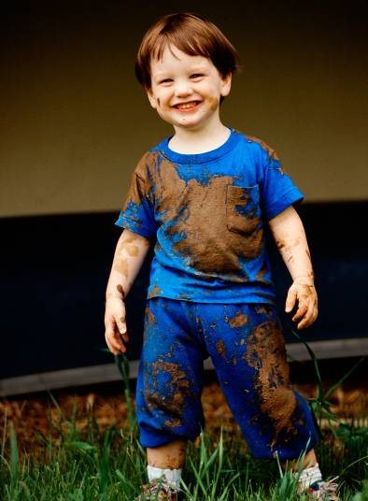
3-4 USING FREQUENCY ADVERBS WITH BE
Jeff is
always dirty.

Slide 27
3-4 USING FREQUENCY ADVERBS WITH BE
SUBJECT + BE + FREQUENCY
ADVERB
seldom
usually
never
often
rarely
dirty.
always
Jeff + is +
sometimes
am
is +
are
FREQUENCY ADVERB

Slide 28
3-4 USING FREQUENCY ADVERBS WITH BE
SUBJECT + FREQUENCY + OTHER SIMPLE
ADVERB PRESENT VERBS
+
seldom
Sergio
sometimes
usually
rarely
never
often
+ rides a bike.
always
all simple
present
verbs
except be
frequency adverb +

Slide 29
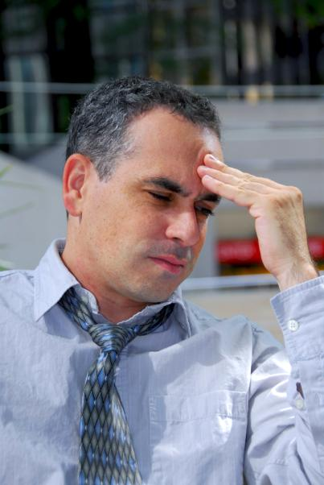
3-4 Let’s Practice
He is
tired.
usually
______________________________________

Slide 30
3-4 Let’s Practice
Jeff is
sad.
never
_________________________________________

Slide 31
Lucy
3-4 Let’s Practice
reads at the library.
often

Slide 32
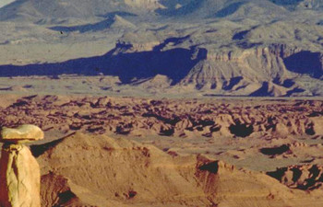
3-4 Let’s Practice
It
rains in the desert.
rarely

Slide 33
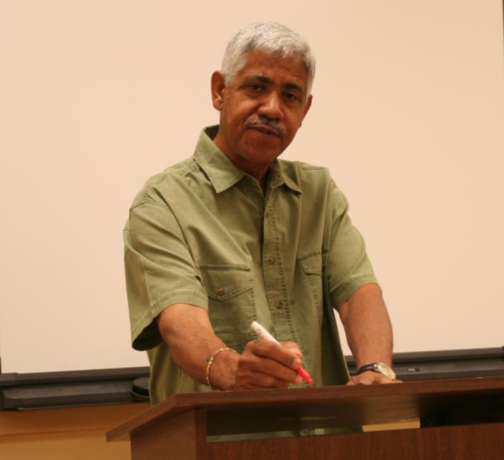
3-5 SPELLING AND PRONUNCIATION OF FINAL -ES
Gerardo teaches math.

Slide 34
3-5 SPELLING AND PRONUNCIATION OF FINAL -ES
SPELLING
PRONUNCIATION
-sh
(a) push
pushes
push /əz/
-ch
(b) teach
teaches
teach /əz/
-ss
(c) kiss
kisses
kiss / z/
ə
-x
(d) fix
fixes
fix / z/
ə
endings
add -es
say
/əz/

Slide 35
3-5 Let’s Practice
miss
Seung never ______
his TV program.
misses

Slide 36
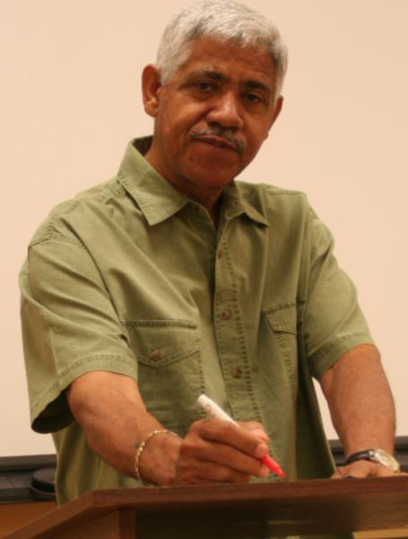
3-5 Let’s Practice
teach
Gerardo _______ math.
teaches

Slide 37
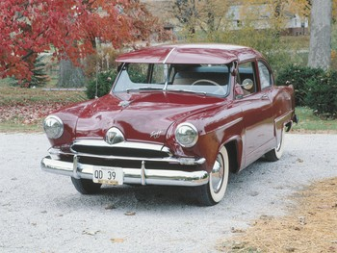
3-5 Let’s Practice
wash
washes
Viktor always _______ his car.

Slide 38
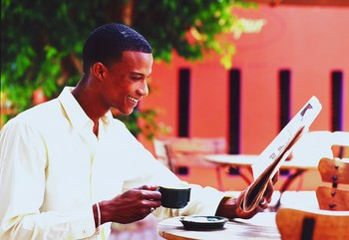
3-5 Let’s Practice
mix
Ade usually ______ sugar
in his coffee.
mixes

Slide 39
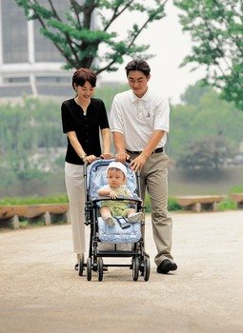
3-6 ADDING FINAL -S / -ES TO WORDS THAT END IN -Y
The baby cries a lot.

Slide 40
3-6 ADDING FINAL -S / -ES TO WORDS THAT END IN -Y
(a) cry
cries
consonant + -y
change y to i,
add -es
fly
flies
(b) pay
pays
vowel + -y
add -s
enjoy
enjoys

Slide 41
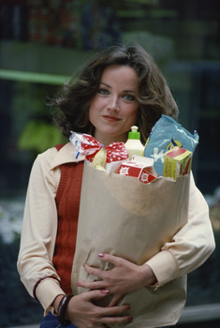
3-6 Let’s Practice
buy often
Gazi _________ too many things.
often buys

Slide 42
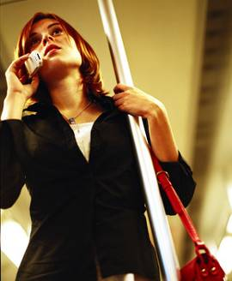
3-6 Let’s Practice
say always
always says
She __________ nice things.

Slide 43
3-6 Let’s Practice
worry often
Her father __________ about her.
often worries

Slide 44
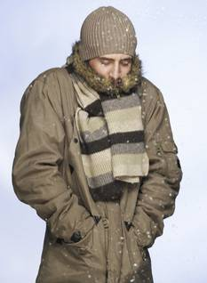
3-7 IRREGULAR SINGULAR VERBS: HAS, DOES, GOES
The man has a brown coat.

Slide 45
3-7 IRREGULAR SINGULAR VERBS: HAS, DOES, GOES
Irregular forms:
she
he
it
(a) I have a hat.
+
has
(b) She has a hat.
have
has
she
he
it
(c) I do exercises.
(d) He does exercises.
does
+
do
does
she
he
it
(e) We go to the gym.
(f) He goes to the gym.
+
goes
go
goes

Slide 46
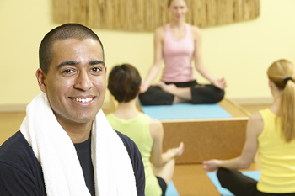
3-7 Let’s Practice
do does
George ____ yoga every day.
does

Slide 47
3-7 Let’s Practice
go goes
Zhou-li ______ for a walk on Sunday.
goes

Slide 48
3-7 Let’s Practice
have has
She always ____ homework.
has

Slide 49
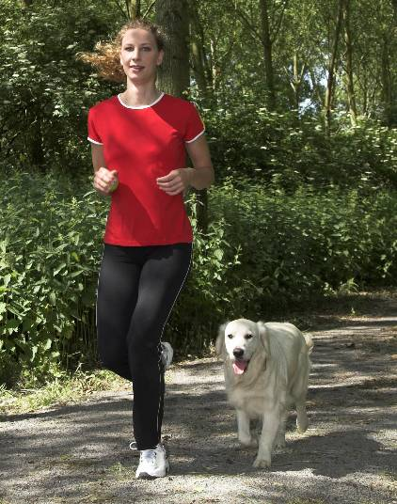
3-8 SPELLING AND PRONUNCIATION OF FINAL -S / -ES
She runs six miles every day.

Slide 50
3-8 SPELLING AND PRONUNCIATION OF FINAL -S / -ES
SPELLING
PRONUNCIATION
(a) run
runs
rain
rains
-s as /z/
voiced
scrub
scrubs
love
loves
3rd person singular add -s

Slide 51
3-8 SPELLING AND PRONUNCIATION OF FINAL -S I -ES
SPELLING
PRONUNCIATION
(b) sink
sinks
meet
meets
-s as /s/
voiceless
fight
fights
cough
coughs
3rd person singular add -s

Slide 52
3-8 SPELLING AND PRONUNCIATION OF FINAL -S I -ES
SPELLING
PRONUNCIATION
(c) push
pushes
watch
watches
-es as /əz/
miss
misses
tax
taxes
-sh, -ch, -ss, -x
3rd person singular add -es

Slide 53
3-8 SPELLING AND PRONUNCIATION OF FINAL -S I -ES
SPELLING
PRONUNCIATION
(d) dry
dries
study
studies
-es as /əz/
consonant + -y
3rd person singular
change y to i, add -es

Slide 54
3-8 SPELLING AND PRONUNCIATION OF FINAL -S I -ES
SPELLING
PRONUNCIATION
(e) pay
pays
buy
buys
-s as /z/
vowel + -y
3rd person singular
add -s

Slide 55
3-8 SPELLING AND PRONUNCIATION OF FINAL -S I -ES
SPELLING
PRONUNCIATION
(f) have
has
/ha z/
e
go
goes
/gowz/
do
does
/d z/
e
3rd person singular forms
irregular

Slide 56
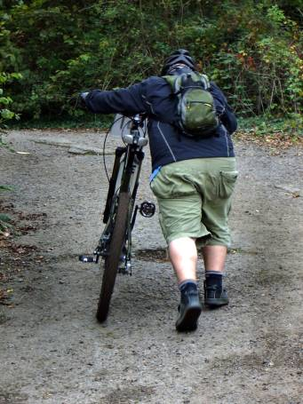
3-8 Let’s Practice
push
Mark ______ his
bike up the hill
every afternoon.
pushes

Slide 57
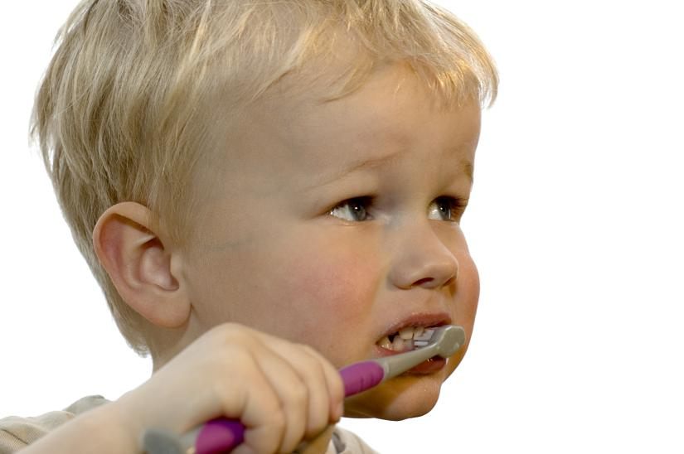
3-8 Let’s Practice
The child _______ his
teeth every morning.
brushes
brush

Slide 58
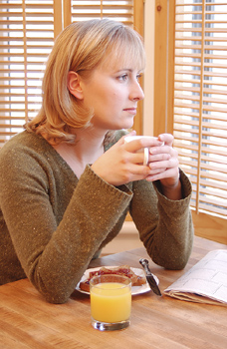
3-8 Let’s Practice
dream
Brenda often ______
about her old home.
dreams

Slide 59
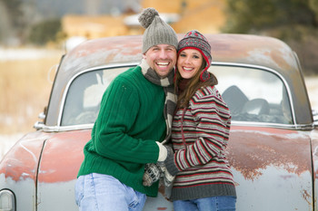
3-9 THE SIMPLE PRESENT: NEGATIVE
They do not wash their car.

Slide 60
3-9 THE SIMPLE PRESENT: NEGATIVE
They
We
You
I
(a) do not drink milk.
I
We
You
They
NEGATIVE:
+ do not + main verb
He
She
It
(b) does not drink milk.
She
He
It
+ does not + main verb

Slide 61
3-9 THE SIMPLE PRESENT: NEGATIVE
I do not drink milk.
She does not drink milk.
do and does = helping verbs
?
She does not drinks milk.
3rd person singular no -s on main verb

Slide 62
3-9 THE SIMPLE PRESENT: NEGATIVE
(c) I don’t drink milk.
They don’t go to the lake.
(d) He doesn’t drink milk.
Jack doesn’t like dogs.
CONTRACTIONS:
do not = don’t
does not = doesn’t

Slide 63
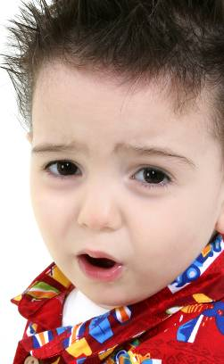
3-9 Let’s Practice
smile not
This child ___________.
doesn’t smile
(use the contraction)

Slide 64
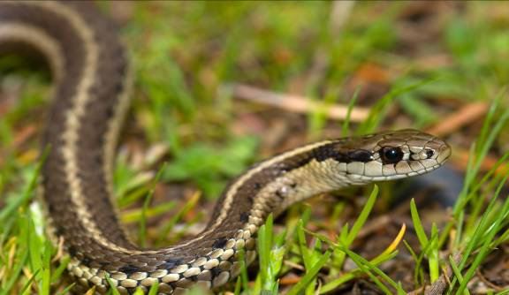
3-9 Let’s Practice
We ________ snakes.
don’t like
like not
(use the contraction)

Slide 65
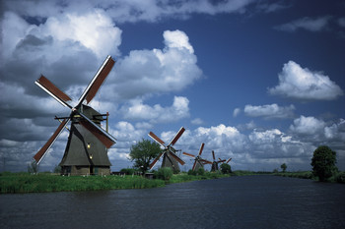
3-9 Let’s Practice
Magda ___________ Dutch.
doesn’t speak
(use the contraction)
speak
not

Slide 66
3-9 Let’s Practice
don’t
doesn’t
feed
jump
run
speak
don’t
feed
Sometimes I ____ ____ my cat.
My husband _____ her.
feeds

Slide 67
3-9 Let’s Practice
don’t
doesn’t
sit
need
like
run
doesn’t
run
She ______ ____ fast at the gym.
She gets tired.

Slide 68
3-9 Let’s Practice
don’t
doesn’t
feed
jump
need
eat
They are good cooks.
need
don’t
They ____ ____ help.

Slide 69
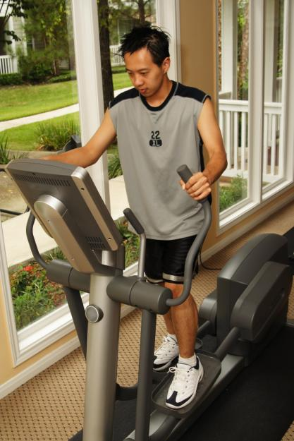
3-10 THE SIMPLE PRESENT: YES/NO QUESTIONS
Does he exercise?

Slide 70
3-10 THE SIMPLE PRESENT: YES/NO QUESTIONS
DO/ + SUBJECT + MAIN
DOES VERB
(b) Do you like salad?
(c) Do we like salad?
(d) Do they like salad?
(a) Do I like salad?
QUESTION FORMS, SIMPLE PRESENT
Do you + main verb
(simple form)
Do we + main verb
(simple form)
Do they + main verb
(simple form)
Do I + main verb
(simple form)

Slide 71
3-10 THE SIMPLE PRESENT: YES/NO QUESTIONS
DO/ + SUBJECT + MAIN
DOES VERB
(g) Does it look good?
(e) Does she like salad?
(f) Does he like salad?
QUESTION FORMS, SIMPLE PRESENT
Does it + main verb
(simple form)
Does she + main verb
(simple form)
Does he + main verb
(simple form)

Slide 72
3-10 THE SIMPLE PRESENT: YES/NO QUESTIONS
(h) Are you a student?
NOT: Do you be a student?
main verb = a form of be
do

Slide 73
3-10 THE SIMPLE PRESENT: YES/NO QUESTIONS
QUESTION SHORT ANSWER
(i) Do you like ice cream?
Yes, I do.
No, I don’t.
(j) Does Max like ice cream?
Yes, he does.
No, he doesn’t.

Slide 74
3-10 Let’s Practice
Question
Do you like to ride horses?
Short Answer
Yes, I do.
Long Answer
I like to ride horses.

Slide 75
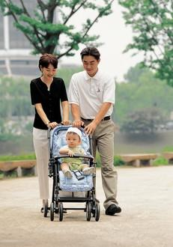
3-10 Let’s Practice
Question
Do they have a baby?
Short Answer
Yes, they do.
Long Answer
They have a baby.

Slide 76
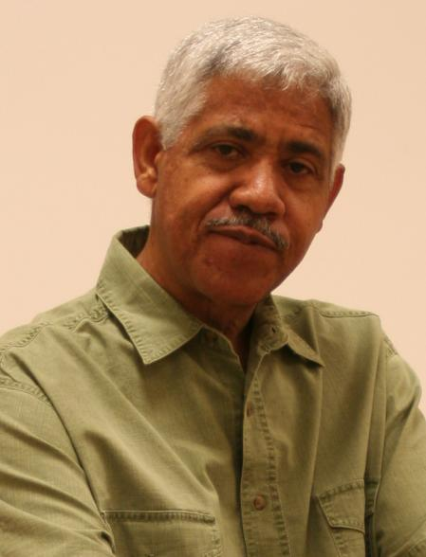
3-10 Let’s Practice
Question
Does Gerardo teach math?
Short Answer
Yes, he does.
Long Answer
Gerardo teaches math.

Slide 77
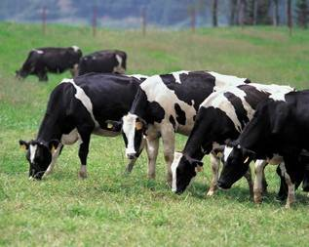
3-10 Let’s Practice
Question
Do cows bark?
Short Answer
No, they don’t.
Long Answer
Cows don’t bark.

Slide 78
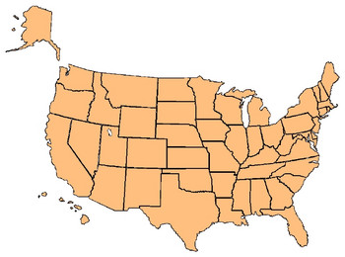
3-11 THE SIMPLE PRESENT: ASKING INFORMATION
QUESTIONS WITH WHERE
Where do they live?
Do they live in Baltimore?
*

Slide 79
3-11 THE SIMPLE PRESENT: ASKING INFORMATION
QUESTIONS WITH WHERE
QUESTION SHORT ANSWER
(a) Do they live in Baltimore?
Yes, they do.
No, they don’t.
(b) Where do they live?
In Baltimore.

Slide 80
3-11 THE SIMPLE PRESENT: ASKING INFORMATION
QUESTIONS WITH WHERE
QUESTION SHORT ANSWER
(c) Does Alexi live in Moscow?
Yes, he does.
No, he doesn’t.
(d) Where does he live?
In Cape Town.

Slide 81
3-11 THE SIMPLE PRESENT: ASKING INFORMATION
QUESTIONS WITH WHERE
(WHERE)
+
DO/DOES
+
SUBJECT
+
MAIN VERB
(a) in Baltimore
Do
they
live
?
(b) Where
do
they
live
?
(c) in Moscow
Does
Alexi
live
?
(d) Where
does
he
live
?

Slide 82
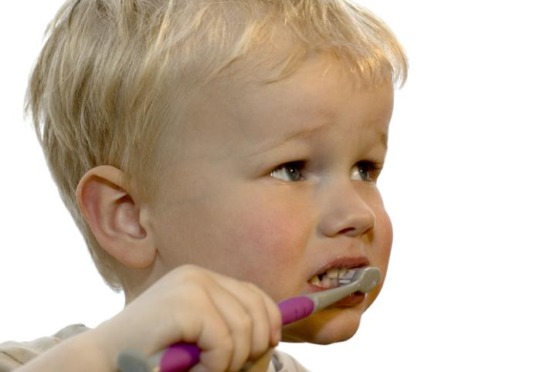
3-11 Let’s Practice
Question:
Answer: Yes, he does.
(The child has a toothbrush.)
Does the child have a toothbrush?

Slide 83

3-11 Let’s Practice
Question:
Answer: In the bathroom.
Where does he brush his teeth?
(He brushes his teeth in the bathroom.)

Slide 84
3-11 Let’s Practice
Question:
Answer: Yes, she does.
Does Lucy like to read at the library?
(Lucy likes to read at the library.)

Slide 85
3-12 THE SIMPLE PRESENT: ASKING INFORMATION
QUESTIONS WITH WHEN AND WHAT TIME
When do you go shopping?
What time do you go shopping?

Slide 86
3-12 THE SIMPLE PRESENT: ASKING INFORMATION
QUESTIONS WITH WHEN AND WHAT TIME
Q-WORD + DO/ + SUBJECT + MAIN
DOES VERB
(a) When do you go to work?
At eight o’clock.
(b) What time do you go to work?
At eight o’clock.

Slide 87
3-12 THE SIMPLE PRESENT: ASKING INFORMATION
QUESTIONS WITH WHEN AND WHAT TIME
Q-WORD + DO/ + SUBJECT + MAIN
DOES VERB
(c) When does he exercise?
At ten o’clock.
(d) What time does he exercise?
At ten o’clock.

Slide 88
3-12 THE SIMPLE PRESENT: ASKING INFORMATION
QUESTIONS WITH WHEN AND WHAT TIME
Q-WORD + DO/ + SUBJECT + MAIN VERB
DOES
(e) What time do you usually go to class?
frequency
adverb
main
verb
subject
+
+

Slide 89
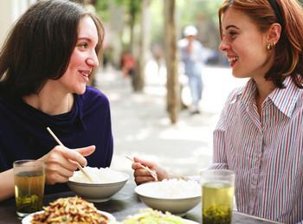
3-12 Let’s Practice
does the pool close?
The pool closes at 6:00 P.M.
When (What time)

Slide 90
3-12 Let’s Practice
do you eat lunch?
When (What time)
I eat lunch at 12:00.

Slide 91
3-12 Let’s Practice
When (What time) do you usually go
to bed
_________________________________________?
I usually go to bed at 11:00.

Slide 92
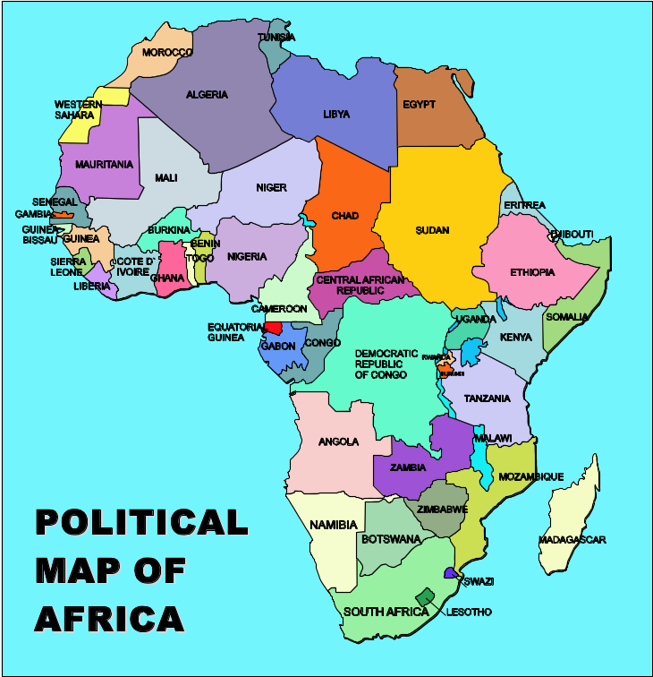
3-13 SUMMARY: INFORMATION QUESTIONS WITH BE
AND DO
Q-WORD + BE + SUBJECT LONG ANSWER
(a) Where is Botswana?
Botswana is in Africa.

Slide 93
3-13 SUMMARY: INFORMATION QUESTIONS WITH BE
AND DO
Q-WORD + BE + SUBJECT LONG ANSWER
(b) Where are your gloves?
They are at home.
(c) When is lunch?
Lunch is at noon.
(d) What is your name?
My name is Uma.
(e) What time is the movie?
The movie is at 5:00.

Slide 94
3-13 SUMMARY: INFORMATION QUESTIONS WITH BE
AND DO
Q-WORD + DO + SUBJECT + MAIN VERB
(f) Where does she live?
She lives in Belgium.
(g) What time does school start?
It starts at 9:00 A.M.
(h) What does she play?
She plays tennis.
(i) When do you study?
I study at night.

Slide 95
3-13 Let’s Practice
is are does do
do
Where ____ they buy food?

Slide 96
3-13 Let’s Practice
is are does do
does
What time _____ the train leave?

Slide 97
3-13 Let’s Practice
is are does do
is
When ____ your test?

Slide 98
3-13 Let’s Practice
is are does do
are
What ____ their names?

Slide 99
PHOTO CREDITS
Images used under license from:
Shutterstock, Inc.
Clipart.com

